Slide 1


Module 9 – Data Quality

Slide 2

Importance of Data Quality
Governance and Oversight
Data quality empowers data owners and governance domains to assess their data ecosystem effectively, ensuring reliability.
AI and Data Reliability
The accuracy of AI insights relies heavily on trustworthy data, affecting decision-making and adoption rates.
No-Code Data Quality Rules
No-code and low-code rules allow users to evaluate data quality simply and efficiently, enhancing accessibility.
Continuous Improvement
Iterative data profiling enhances accuracy and supports the ongoing refinement of AI models for better insights.
Notes:
It’s a core feature of the Unified Data Catalog, enabling data stewards and governance teams to ensure that data is accurate, complete, and reliable for analytics, reporting, and AI-driven decision-making.
Data quality in Microsoft Purview refers to the ability to measure, monitor, and improve the trustworthiness and usability of data across your organization.

Slide 3
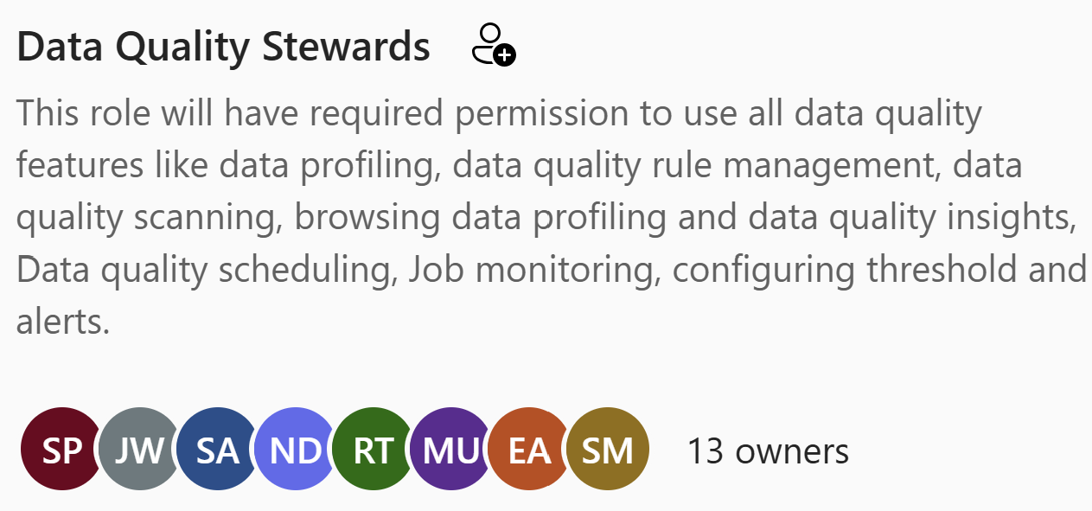
Assign Permissions
User Roles Definition
Define user roles to ensure proper access levels for data quality stewards in the Unified Catalog.
Assigning Permissions
Grant data quality steward permissions to users to enable access to all necessary data quality features.
Data Quality Reader
Provides users with read-only access to data quality information and reports within the Unified Catalog. This role allows users to view data quality rules, scans, and overall health reports, enabling them to monitor the quality of their organization's data.
Notes:
Roles

Slide 4
Data Quality Lifecycle
Notes:
Data Quality is not a one off job and need a certain process to follow to ensure the relevant data quality rules are applied and data quality score which you see at the end is a product of a specific set of process

Slide 5

Register and Scan Data Source
Data Source Registration
Registering a data source is essential for tracking and managing your data assets effectively.
Data Scanning Process
Scanning the data source helps in understanding its structure and ensuring data quality.
Data Product Integration
Once registered and scanned, your data assets can be integrated into a data product for further use.
Notes:
Register and scan a data source in your Microsoft Purview Data Map. Add your data asset to a data product

Slide 6

Set Up Data Source Connection
Data Source Preparation
Establishing a connection to the data source is essential for ensuring data quality. Proper setup enables effective assessment.
Quality Assessment Readiness
Preparing your data source is a crucial step in assessing and improving data quality, leading to more accurate results.
Notes:
Set up a data source connection to prepare your source for data quality assessment.

Slide 7

Configure and Run Data Profiling
Data Profiling Configuration
Start by configuring the data profiling process for the desired asset in your data source to ensure accurate results.
Review Profiling Results
Once profiling is complete, review the results to analyze each column's structure and data integrity.
Understand Data Structure
Analyze the data's current structure and state to identify areas for improvement or further analysis.
Notes:
Configure and run data profiling for an asset in your data source. When profiling is complete, browse the results for each column in the data asset to understand your data's current structure and state.

Slide 8
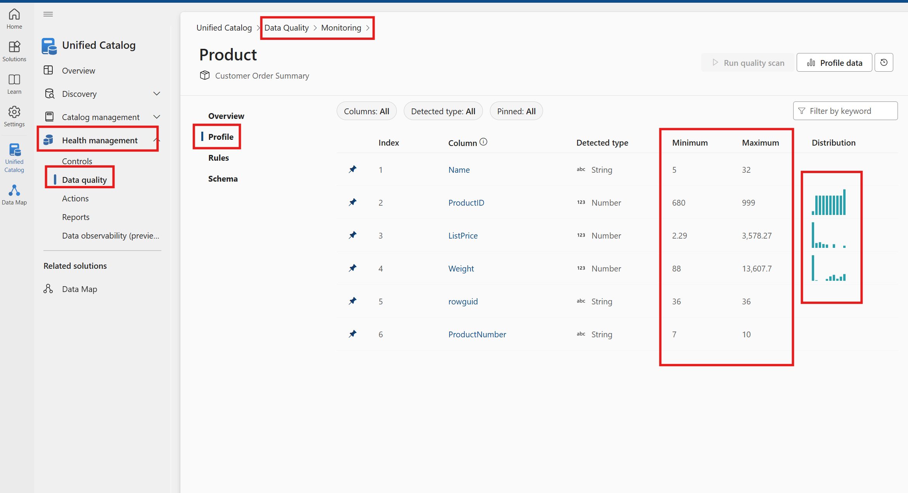

Slide 9

Set Up Data Quality Rules
Rule | Definition
Freshness | Confirms that all values are up to date.
Unique values | Confirms that the values in a column are unique.
String format match | Confirms that the values in a column match a specific format or other criteria.
Data type match | Confirms that the values in a column match their data type requirements.
Duplicate rows | Checks for duplicate rows with the same values across two or more columns.
Empty/blank fields | Looks for blank and empty fields in a column where there should be values.
Table lookup | Confirms that a value in one table can be found in the specific column of another table.
Custom | Create a custom rule with the visual expression builder.
AI assisted autogenerated rules | AI-assisted automated rule generation for data quality measurement involves using artificial intelligence (AI) techniques to automatically create rules for assessing and improving the quality of data.
Notes:
Set up data quality rules based on the profiling results, and apply them to your data asset.

Slide 10

Run Data Quality Scan
Data Quality Assessment
Conducting a data quality scan helps in evaluating the integrity and accuracy of data across all assets.
Configuration Process
Proper configuration is essential for running an effective data quality scan, ensuring all relevant assets are included.
Running the Scan
Initiating the data quality scan provides insights into potential issues and areas for improvement in your data products.
Notes:
Configure and run a data quality scan on a data product to assess the quality of all supported assets in the data product.

Slide 11
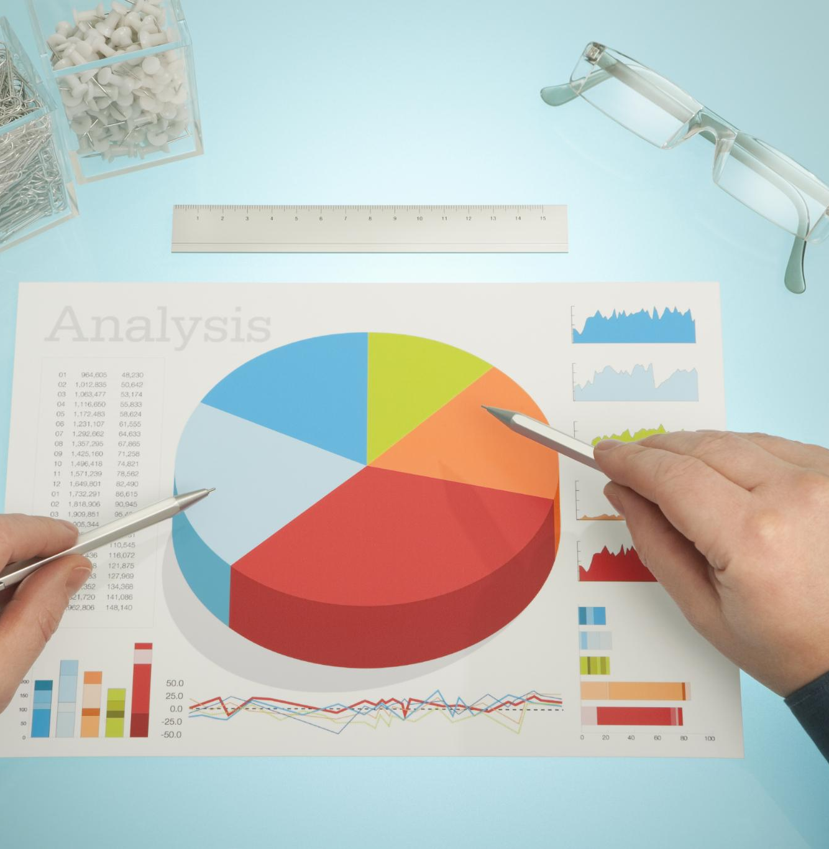
Review Scan Results
Data Quality Evaluation
Assess the quality of your data product by examining various metrics and results from the scan.
Scan Results Analysis
Analyze the scan results to identify any issues that may affect the overall data quality.
Notes:
Review your scan results to evaluate your data product's current data quality.

Slide 12

Repeat Steps Periodically
Periodic Review Process
Implementing a cyclical review process helps to maintain the quality of your data assets over time.
Maintaining Data Quality
Regular maintenance and updates are crucial in keeping data assets functional and high-quality.

Slide 13

Continual Monitoring
Review Data Quality Actions
Regularly assessing data quality actions helps identify and resolve any underlying problems promptly.
Set Data Quality Notifications
Implement notifications to alert your team about quality issues, ensuring timely action and resolution.
Notes:
Continually monitor your data quality a. Review data quality actions to identify and resolve problems. b. Set data quality notifications to alert you to quality issues.

Slide 14
Module – 9
Lab Time

